Slide 1
Data Warehousing, Mining and Web Tools

Slide 2
Contents
Data Warehousing
Data Mining
Web Warehouses
Further Reading

Slide 3
OLTP Systems
So far we have concentrated on OLTP (online transaction processing) systems
  range in size from megabytes to terabytes
  high transaction throughput
Decision makers require access to all data wherever it is located
  current data
  historical data
Notes:
DBMS in industry are pervasive throughout industry. Designed to handle high transaction throughput, where transactions typically make small changes to the operational data, for day-to-day running of the organisation. Can range in size: small databases being mbs where large databases can require terabytes or even petabytes.
Decision makers require access to all the organisation’s data to provide comprehensive analysis of the organisation, its business, its requirements and its trends. This needs access to both current and past data.

Slide 4
OLTP Systems
Holds current data
Stores detailed data
Data is dynamic
Repetitive processing
High level of transaction throughput
Predictable pattern of usage
Transaction driven
Application-oriented
Supports day-to-day decisions
Serves large number of clerical/operational users
Notes:
These are the advantages/benefits of an OLTP (on-line-transaction processing) system. They fit how the system is commonly used.

Slide 5
Data Warehouse Definition
A data warehouse is a
  subject-oriented,
  integrated,
  time-variant and
  non-volatile
collection of data in support of management’s decision-making process (Inmon 1993)
Notes:
A data warehouse is different to an OLTP system in that it fits the definition given on this slide.
Subject oriented: organised around the major subjects of the enterprise (e.g. customers, products, sales) rather than the major application areas (e.g. customer invoicing, stock control, product sales)
Integrated: coming together of the source data from different enterprise-wide applications systems. Often inconsistent, e.g. different formats
Time-variant: data in the warehouse is only accurate at some point in time or over some time interval. Data represents a series of snapshots
Non-volatile: data is not updated in real time, refreshed from operational systems on a regular basis. New data is always added, rather than replaced.

Slide 6
Data Warehousing Systems
Holds historical data
Stores detailed, lightly and highly summarised data
Data is largely static
Ad-hoc, unstructured and heuristic processing
Medium/low level of transaction throughput
Unpredictable pattern of usage
Analysis driven
Subject-oriented
Supports strategic decisions
Serves relatively low no. of managerial users
Notes:
These are the advantages/benefits of a data warehouse system. It is useful for you to compare these to an OLTP system.

Slide 7
Benefits
Potential high returns on investment
  401% return of investment (over three years) for 90% of companies in 1996
Competitive advantage
  data can reveal previously unknown, unavailable and untapped information
Increased productivity of corporate decision-makers
  integration allows more substantive, accurate and consistent analysis
Notes:
These are the benefits.
Organisations normally must commit a huge amount of investment and resources in developing the data warehouse, but the potential returns on that investment due to increasing productivity and the competitive advantage that gives can be very large, the IDC quote is 401% return over three years. The competitive advantage is gained by the access to data that was previously unavailable, and increases productivity as the data is integrated from previously incompatible systems.

Slide 8

Architecture
Mainframe operational
n/w,h/w data
Warehouse mgr
Reporting, query,
application development,
EIS tools
Meta-data
Highly
summarized
data
Departmental
RDBMS data
Load
mgr
Query
manager
Lightly summarized
data
OLAP tools
Private data
Detailed data
DBMS
Warehouse mgr
Data-mining tools
External data
Archive/backup
Notes:
This shows the typical architecture of a data warehouse.
It shows:
Data sources - can vary from mainframes to departmental databases to external data. There are lots of different sources and different data types.
Load manager (or frontend) performs the extraction and loading of data into the warehouse.
Warehouse manager performs all the operations associated with the management of the data in the warehouse. Operations include - ensuring consistency of data, indexes and views, denormalising, aggregating data, backing up and archiving.
Query manager (backend) manages the user queries. Complexity depends on flesibility of end-user access tools. Can include directing queries to tables, scheduling execution of queries, generating query profiles to assist warehouse manager in managing indexes and views.
Detailed data: this is all the detailed data in the schema. Normally stored offline and aggregated into next level of data.
Lightly/highly summarised data: this is the aggregated data generated by the warehouse manager. This is subject to change on an on-going basis depending on the types of queries. Purpose is to speed up queries.
Meta-data: description of data in warehouse. Changes according to structure of data in warehouse.

Slide 9
Information Flows
Operational data
source 1
Warehouse Mgr
Meta-flow
Reporting query, app
development,EIS tools
Meta-
data
Inflow
Highly
summ.
data
Outflow
Load
mgr
Query
manager
OLAP tools
Lightly
summ.
Upflow
Detailed data
DBMS
Warehouse mgr
Data-mining tools
Operational data
source n
Downflow
Archive/backup
Notes:
This diagram shows the main flows of data in the warehouse. The next slide explains each of the five flows.

Slide 10
Information Flow Processes
Five primary information flows
  Inflow - extraction, cleansing and loading of data from source systems into warehouse
  Upflow - adding value to data in warehouse through summarizing, packaging and distributing data
  Downflow - archiving and backing up data in warehouse
  Outflow - making data available to end users
  Metaflow - managing the metadata
Notes:
This explains the processes associated with each of the information flows.

Slide 11
Data Warehouse Design
Data must be designed to allow ad-hoc queries to be answered with acceptable performance constraints
Queries usually require access to factual data generated by business transactions
  e.g. find the average number of properties rented out with a monthly rent greater than £700 at each branch office over the last six months
Uses Dimensionality Modelling
Notes:
The types of queries we need to be able to perform are different to those in an OLTP system as they are more factual, analytical and temporal. An example is given - try doing this in a relational system.
So normal modelling techniques (E-R model) are not suitable as the relationships between the data can sometimes be too complex, therefore we use dimensionality modelling: a logical design technique that aims to present the data in a standard, intuitive form that allows for high-performance access.

Slide 12
Dimensionality Modelling
Similar to E-R modelling but with constraints
  composed of one fact table with a composite primary key
  dimension tables have a simple primary key which corresponds exactly to one foreign key in the fact table
  uses surrogate keys based on integer values
  Can efficiently and easily support ad-hoc end-user queries
Notes:
Our dimensional model is based on the E-R model but with some restrictions, to support the types of queries required. A model with these restrictions is called a Star Schema.

Slide 13
Star Schemas
The most common dimensional model
A fact table surrounded by dimension tables
Fact tables
  contains FK for each dimension table
  large relative to dimension tables
  read-only
Dimension tables
  reference data
  query performance can be speeded up by denormalising into a single dimension table
Notes:
A star schema contains two types of tables as defined. An example is given on the next couple of slides.

Slide 14
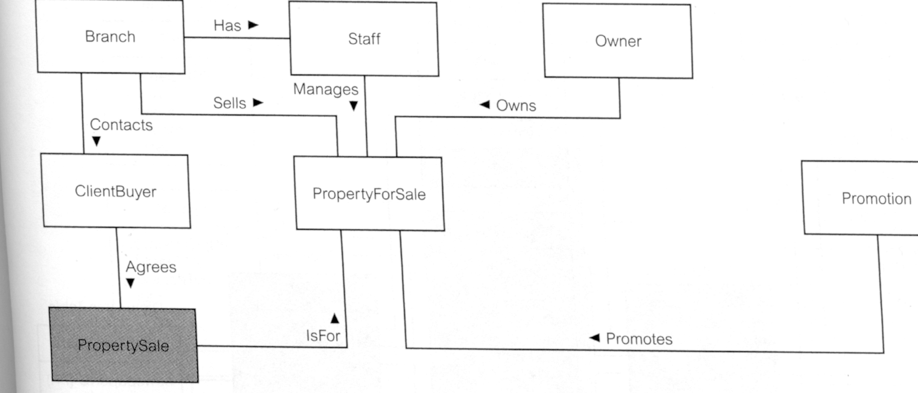
E-R Model Example
Notes:
This is an E-R model taken from Connolly and Begg for the Dream Home database. Notice that it contains complex relationships between the various objects, which would make it different to answer the types of queries required. So we redesign using a star schema as given on the next slide...

Slide 15
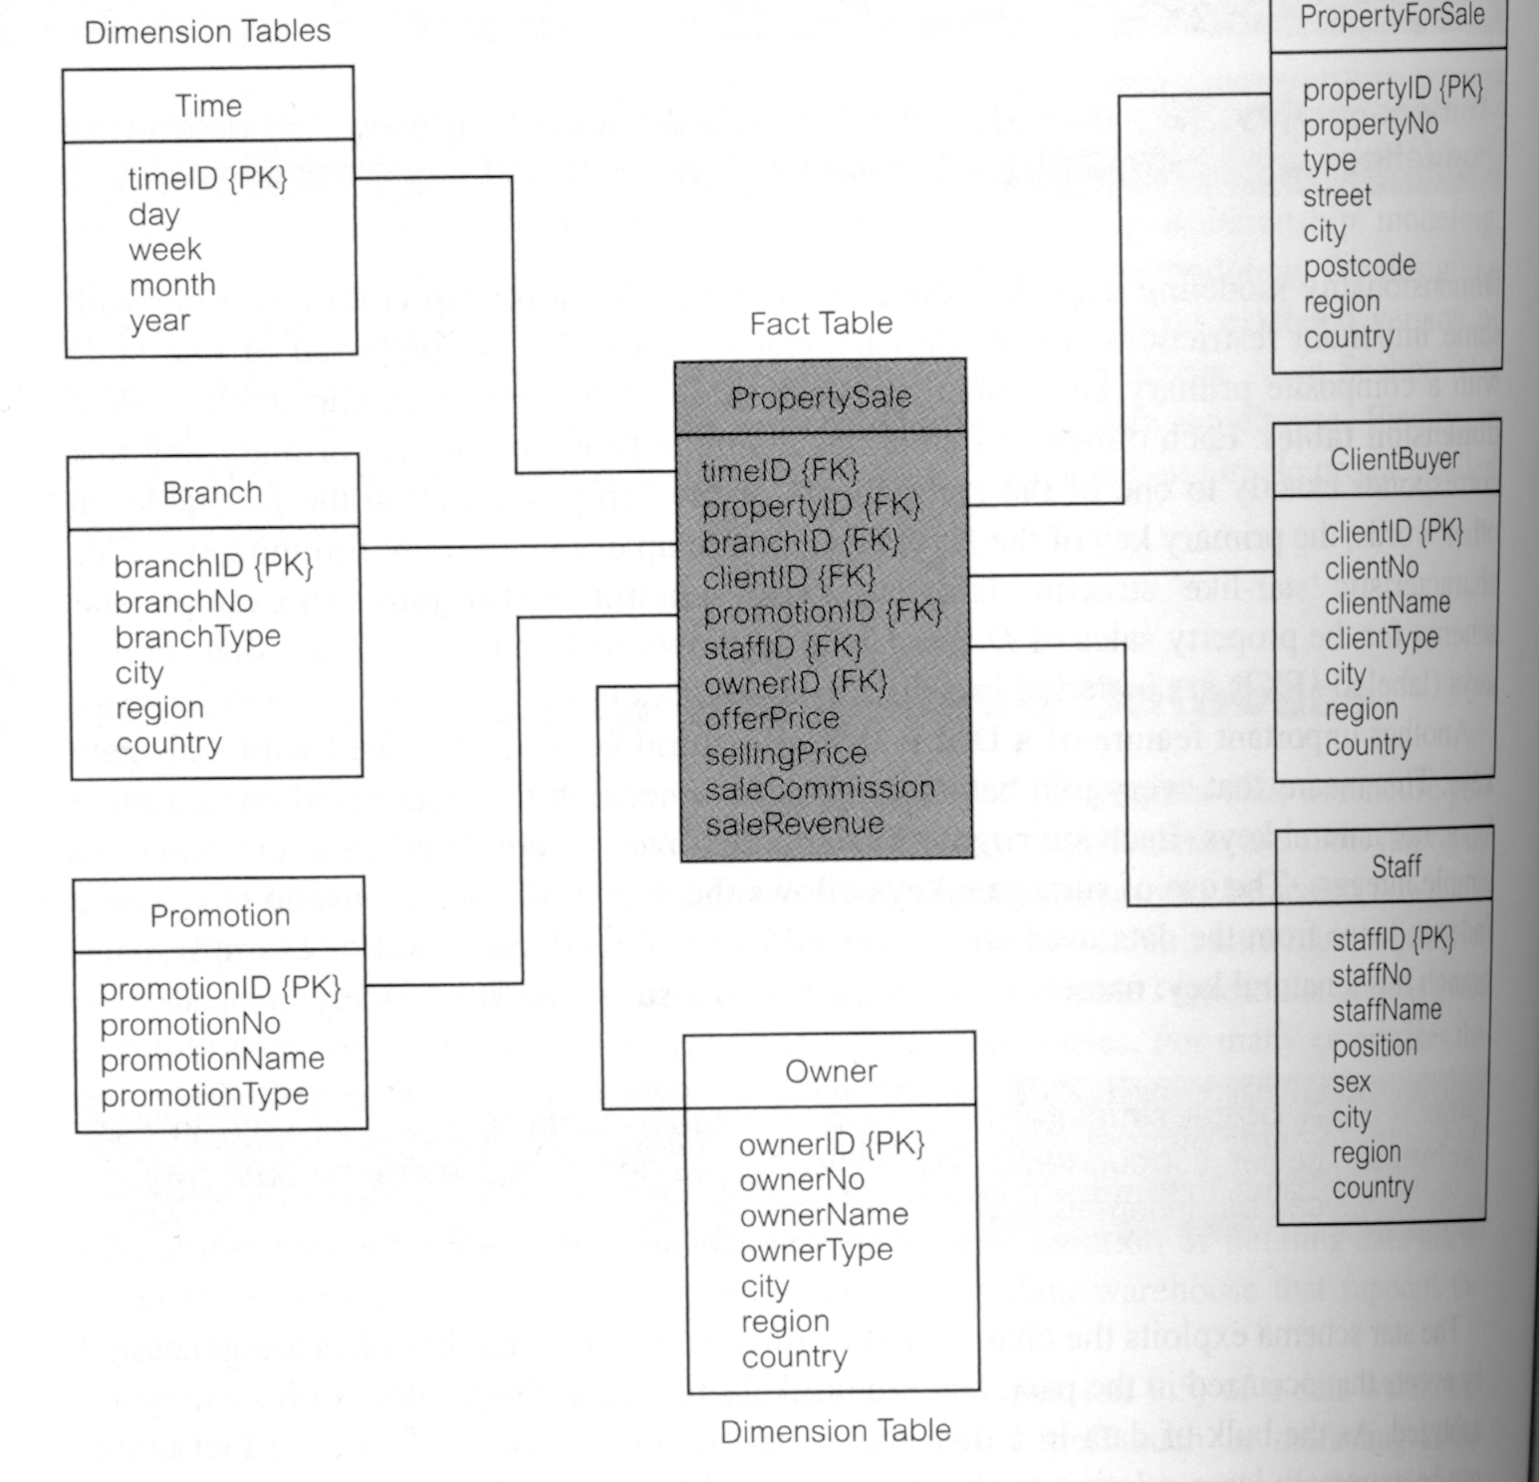
Star Schema Example
Notes:
This is the Star Schema version. Now we have one table in the centre which contains all the links to the dimension tables, which contains the data. The fact table is just like a M:N relationship in a relational database.

Slide 16
Data Mining
The process of extracting valid, previously unknown, comprehensible and actionable information from large databases and using it to make crucial business decisions
  focus is to reveal information which is hidden or unexpected
  patterns and relationships are identified by examining the underlying rules and features of the data
  work from data up
  require large volumes of data
Notes:
There are various end-user tools which can be used with data warehouses, and data mining is one of those sets of tools which is used for analysing data within a database to find hidden/unexpected information within a database.

Slide 17
Example Data Mining Applications
Retail/Marketing
  Identifying buying patterns of customers
  Finding associations among customer demographic characteristics
  Predicting response to mailing campaigns
  Market basket analysis
Notes:
These are some examples of typical applications

Slide 18
Example Data Mining Applications
Banking
  Detecting patterns of fraudulent credit card use
  Identifying loyal customers
  Predicting customers likely to change their credit card affiliation
  Determining credit card spending by customer groups

Slide 19
Data Mining Techniques
Predictive Modelling
  using observations to form a model of the important characteristics of some phenomenon
Techniques:
  Classification
  Value Prediction
Notes:
There are four techniques.
Predictive modelling uses observations to form a model of the important characteristics of some phenomenon. Can be used to analyse an existing database to deterrmine some essential characteristics about the data set. Two main techniques:
Classification: used to establish a specific predetermined class for each record in a database from a finite set of possible class values.
Value prediction: used to estimate a continuous numeric value that is associated with a database record, uses statistical techniques, e.g. linear regression.
An example of classification is given on the next slide.

Slide 20
Classification Example: Tree Induction
Customer renting property
> 2 years
No
Yes
Customer age
> 25 years?
Rent property
No
Yes
Rent property
Buy property

Slide 21
Data Mining Techniques
Database Segmentation:
  to partition a database into an unknown number of segments (or clusters) of records which share a number of properties
Techniques:
  Demographic clustering
  Neural clustering
Notes:
The second technique is database segmentation. Aims to cluster records so that they share a number of properties. Uses unsupervised learning to discover sub-populations in the database.
Two types which is beyond the scope of this lecture. An example is given on the next slide.

Slide 22
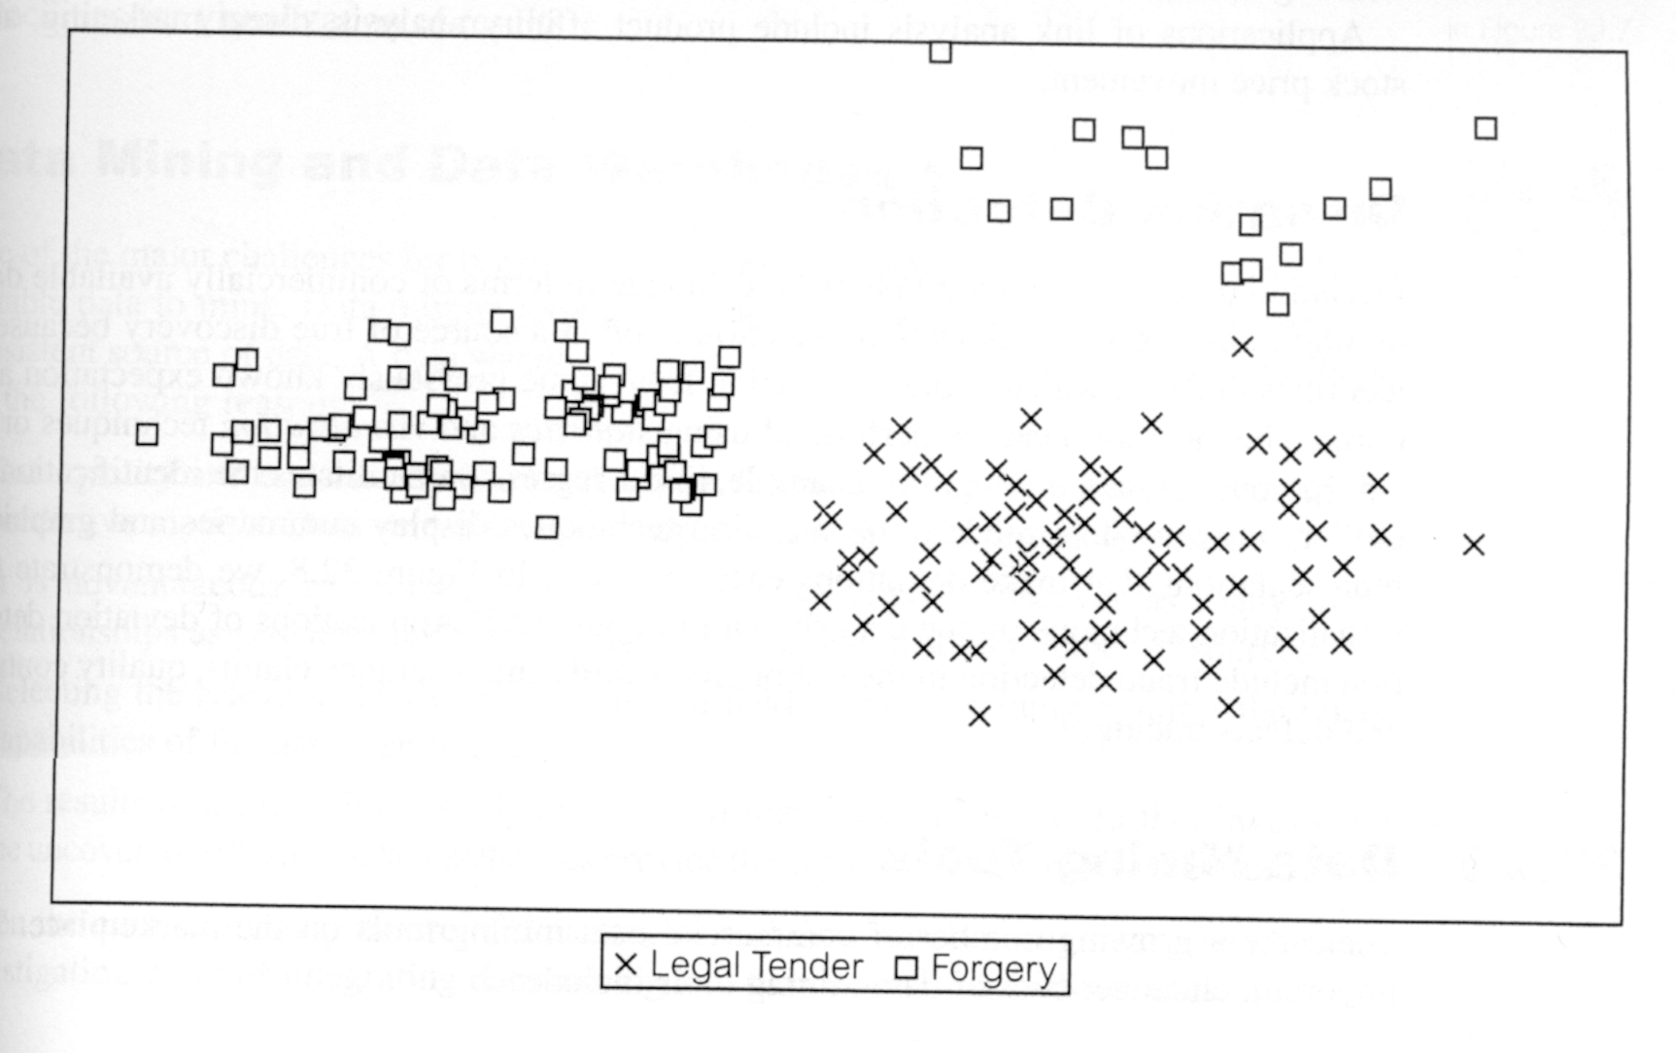
Database Segmentation: Scatterplot Example

Slide 23
Data Mining Techniques
Link Analysis
  establish associations between individual records (or sets of records) in a database
    e.g. ‘when a customer rents property for more than two years and is more than 25 year olds, then in 40% of cases, the customer will buy the property’
  Techniques
  Association discovery
  Sequential pattern discovery
  Similar time sequence discovery
Notes:
Link analysis establishes association between records. An example is given.
Various techniques which look for associations/patterns/similar time sequences.

Slide 24
Data Mining Techniques
Deviation Detection
  identify ‘outliers’, something which deviates from some known expectation or norm
  Statistics
  Visualisation
Notes:
Deviation detections identifies records where a value is out of the ordinary. Can be done either statistically or by visualisation, as in the example on the next slide. Good for fraud detection.

Slide 25
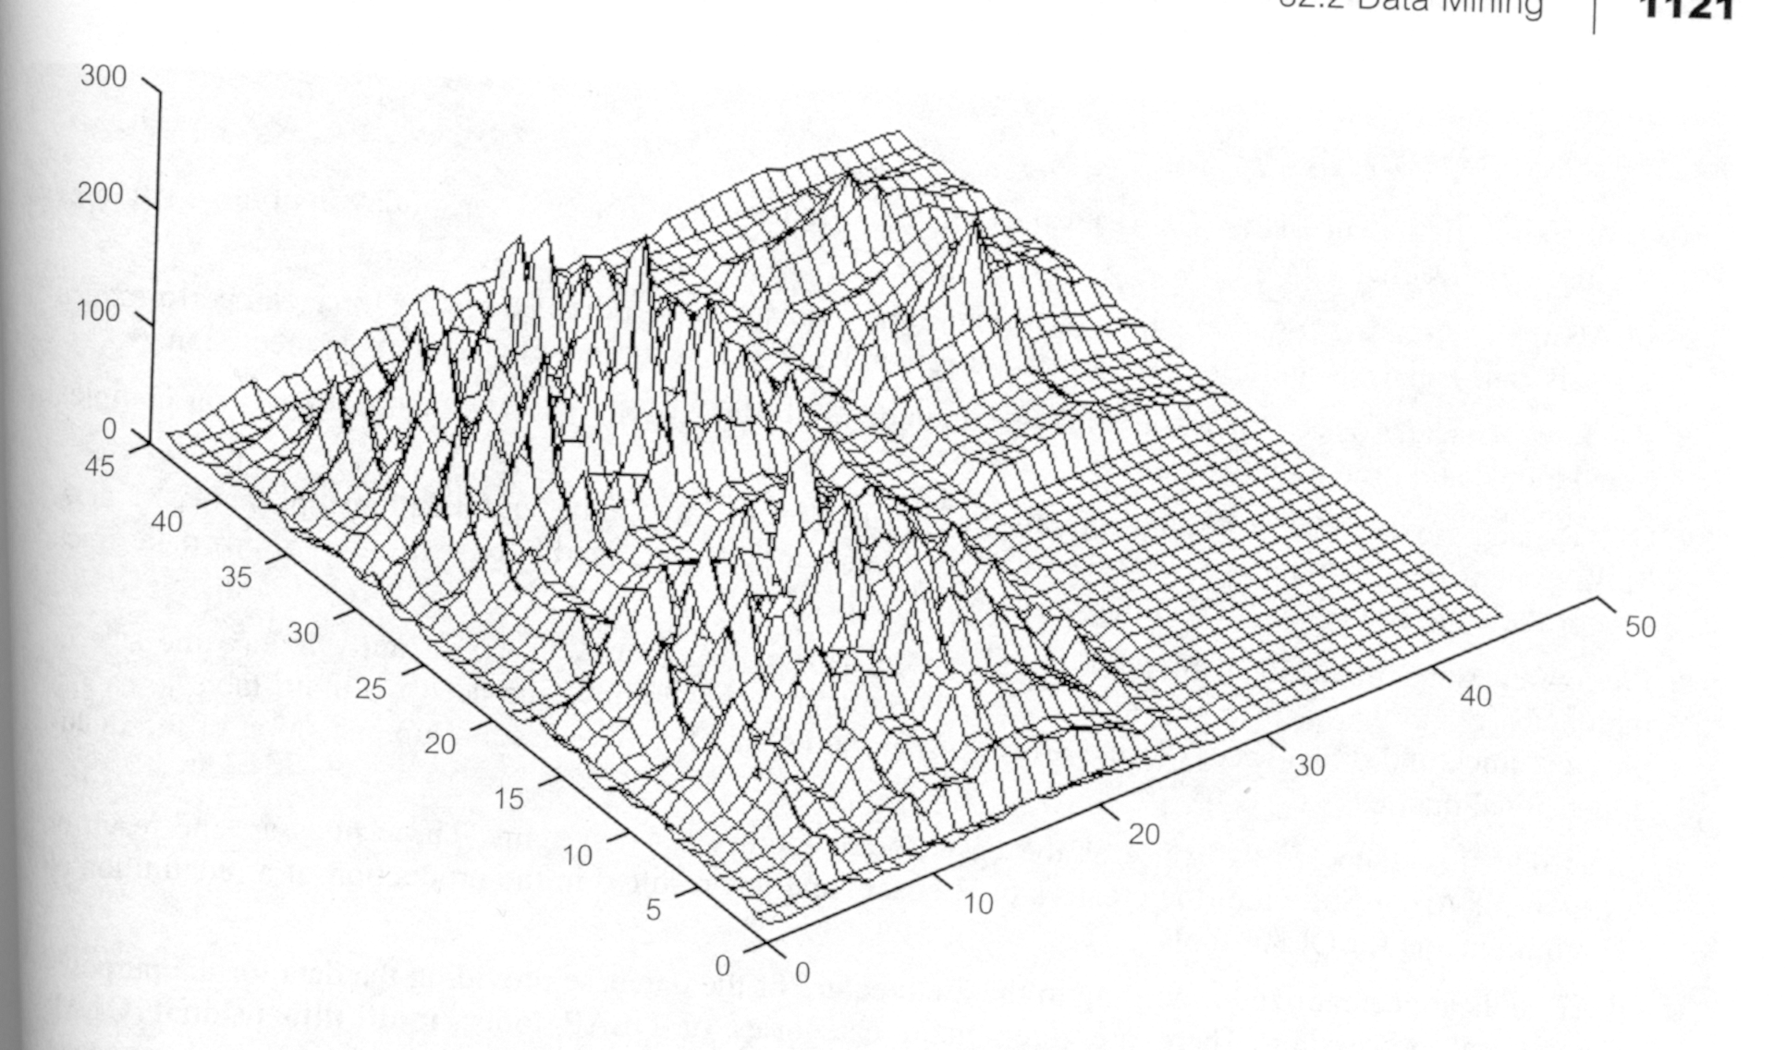
Deviation Detection: Visualisation Example

Slide 26
Mining and Warehousing
Data mining needs single, separate, clean, integrated, self-consistent data source
Data warehouse well equipped:
  populated with clean, consistent data
  contains multiple sources
  utilizes query capabilities
  capability to go back to data source
Notes:
So to finish off on warehousing, if we look at the requirements for a data mining tool and then compare this to what we get from a data warehouse, then we can see that the ideal data source for data mining is a data warehouse.

Slide 27
Web Warehouses
The ultimate data warehouse is the Internet
  contains data in numerous formats
    relational
    object-oriented
    semi-structured
    unstructured ...
It is impossible to store all this data in a warehouse
  imagine the storage required!
So need an intermediary
Notes:
To finish off with something a little different, then if you think about data warehouses, then the ultimate data warehouse is the internet. This has led to the recent development of what are becoming known as web warehouses. Data on the web comes in various formats, including those listed above, but also even including basic HTML and e.g. Word documents.
Think about the storage required if you were to try to build a data warehouse of the internet.
So, we can’t do this therefore we need something which just sits and acts as a warehouse but doesn’t store all the data.

Slide 28
XML
A meta-language that enables designers to create their own customised tags to provide functionality not available within HTML
e.g.
  <STAFF>
    <NAME>
      <FNAME>John</FNAME><LNAME>White</LNAME>
    </NAME>
    <SEX gender=‘M’/>
  </STAFF>
Notes:
XML could be seen as an ideal tool for a web warehouse, so the next couple of slides aims to introduce XML to give you a feel for how this could work.
The definition of XML is that is a language where you define your own tags, e.g. the <a href></a> and <p></p> bits in HTML. So you can create documents in XML to represent whatever you want - c.f. database! An example is given on this slide.

Slide 29
XML Tools
Can define stylesheets to display XML database in web pages
Can write queries:
  WHERE <STAFF>
  <GENDER>$$</GENDER>
  <NAME><FNAME>$F</FNAME><LNAME>$L</LNAME></NAME>
  $$ = ‘M’
  CONSTRUCT <LNAME>$L</LNAME>
To build a warehouse can develop a representation of data models in XML
Good as a common format for EDI
Notes:
This is good, but we need to be able to display or do something with the data. We can therefore define stylesheets which specify what to do with those tags - similar to the <p> in html means start a new paragraph.
Even better, new work is in being able to query XML databases, an example query is given above to print the last name of all staff whose sex is M. It looks complicated but if you read it carefully you should be able to follow it.
Now just to finish off, think about how this could be used for a web house.
EDI- electronic data interchange.

Slide 30
Further Reading
Connolly and Begg, chapters 30, 31 and 32.
W H Inmon, Building the Data Warehouse, New York, Wiley and Sons, 1993.
White Paper on Global, XML Repositories for XML/EDI.
  http://ww.xmledi.com/repository/xml-repWP.htm
Notes:
Note that all photocopies and examples have come from Connolly and Begg.

